Slide 1

Cloud Computing and Distributed Systems
Session-5 (Week-6)
Mayank Taneja,
Teaching Assistant

Slide 2
Q. 1 True or False ?
Cassandra uses a Gossip protocol called to discover location and state information.
A. True
B. False

Slide 3
Answer: A) True
Gossip is a peer-to-peer communication protocol in which nodes periodically exchange state information about themselves and about other nodes they know about.
The gossip process runs every second and exchanges state messages with up to three other nodes in the cluster.
The nodes exchange information about themselves and about the other nodes that they have gossiped about, so all nodes quickly learn about all other nodes in the cluster.
Nodes also periodically send heartbeat messages to check if other nodes are up and live.

Slide 4
Q. 2 Fill the correct choices for the given scenarios:
__________________ : When thousands of customers are looking to book a flight, all updates from any client (e.g.- book a flight) should be accessible by other clients.
_________________ : Reads/writes complete reliably and quickly.
_________________: Can happen across datacenters when the Internet gets
disconnected.
A. Availability, Consistency, Partitioning
B. Consistency, Availability, Partitioning
C. Partitioning, Consistency, Availability
D. Consistency, Partitioning, Availability

Slide 5
Answer: B) Consistency, Availability, Partitioning
CAP Theorem:
Consistency:
Consistency means that all clients see the same data at the same time, no matter which node they connect to. For this to happen, whenever data is written to one node, it must be instantly forwarded or replicated to all the other nodes in the system before the write is deemed ‘successful.’
Availability:
Availability means that any client making a request for data gets a response, even if one or more nodes are down. Another way to state this—all working nodes in the distributed system return a valid response for any request, without exception.
Partition-tolerance:
A partition is a communications break within a distributed system—a lost or temporarily delayed connection between two nodes. Partition tolerance means that the cluster must continue to work despite any number of communication breakdowns between nodes in the system.

Slide 6
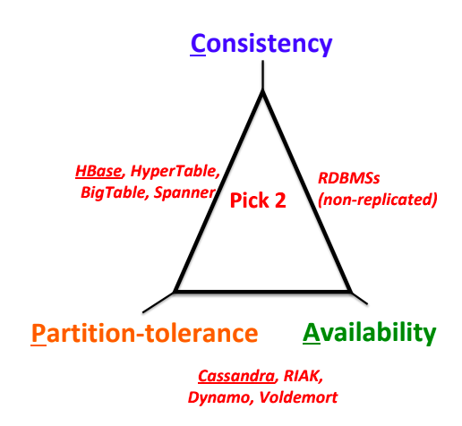

Slide 7
Q. 3 ______________is an open-source distributed, column-store NoSQL database, which is designed to operate on top of the Hadoop distributed file system (HDFS).
A. Hbase
B. Zookeeper
C. SQL
D. Distributed Hash tables (DHT)

Slide 8
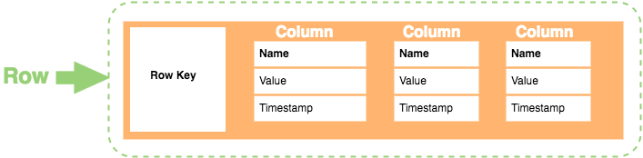
Answer: A) Hbase
Column-Store Database
A column store database is a type of database that stores data using a column oriented model.
RDBMSs store an entire row together
Column-store systems typically store a group of columns together
Row Key: Each row has a unique key, which is a unique identifier for that row.
Column: Each column contains a name, a value, and timestamp.
Name: This is the name of the name/value pair.
Value: This is the value of the name/value pair.
Timestamp: This provides the date and time that the data was inserted. This can be used to determine the most recent version of data.

Slide 9
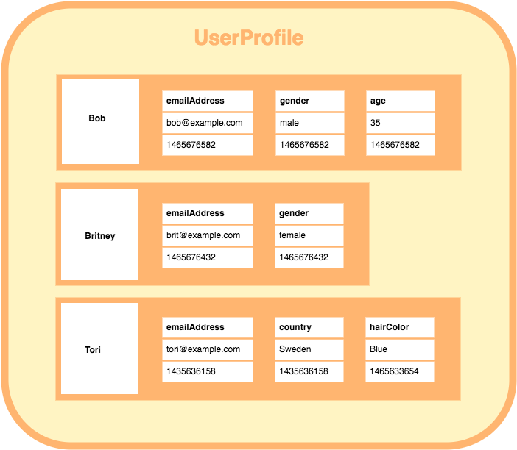
A column family consists of multiple rows.
Each row can contain a different number of columns to the other rows. And the columns don’t have to match the columns in the other rows (i.e. they can have different column names, data types, etc)
Each column is contained to its row. It doesn’t span all rows like in a relational database. Each column contains a name/value pair, along with a timestamp. Note that this example uses Unix/Epoch time for the timestamp.

Slide 10
Q. 4 Choose the correct items for X, Y, and Z.
X is a free and open-source, distributed, wide column store, Y database
management system designed to handle large amounts of data across many
commodity servers, providing high availability with no Z.
A. X- Apache Cassandra, Y- SQL, Z- single point of failure
B. X- Hbase, Y- NoSQL, Z- failure
C. X- Zookeeper, Y- NoSQL, Z- multiple failure
D. X- Apache Cassandra, Y- NoSQL, Z- single point of failure

Slide 11
Answer: D) X- Apache Cassandra, Y- NoSQL, Z- single point of failure
Apache Cassandra is a free and open-source, distributed, wide column store, NoSQL database management system designed to handle large amounts of data across many commodity servers, providing high availability with no single point of failure.

Slide 12
Q. 5 A small chunk of data residing in one machine which is part of a cluster of
machines holding one Hbase table is known as__________________
A. Row-area
B. Table-area
C. Split
D. Region

Slide 13
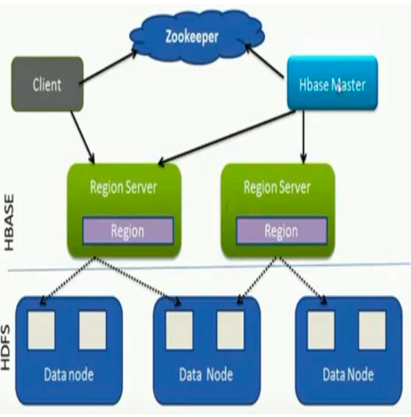
HBase Architecture
Table Split into regions and served by region servers.
Regions vertically divided by column families into “stores”.
Stores saved as files on HDFS
Hbase utilizes zookeeper for distributed coordination

Slide 14
HBase Components
Client
Finds RegionServers that are serving particular row range of interest
HMaster
Monitoring all RegionServer instances in the cluster
Regions
Basic element of availability and distribution for tables
RegionServer
Serving and managing regions
In a distributed cluster, a RegionServer runs on a DataNode

Slide 15
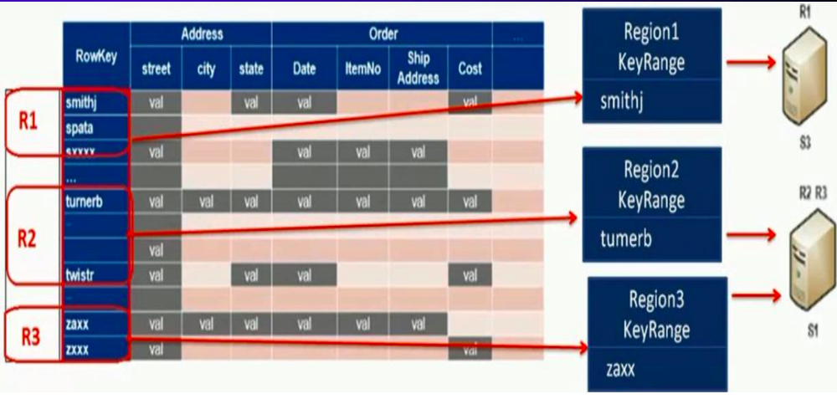
Tables are divided into sequences of rows, by key range, called regions.
These regions are then assigned to the data nodes in the cluster called“RegionServers.”

Slide 16
Q. 6 Choose the correct items for X, Y, and Z
X in HBase Table is a combination of row-key, Y, Z and contains a value and a
timestamp.
A. X- Row, Y- row family, Z- row qualifier
B. X- Cell, Y- column family, Z- column qualifier
C. X- Row, Y- rowkey, Z- column qualifier
D. X- Rowkey, Y- column family, Z- column qualifier

Slide 17
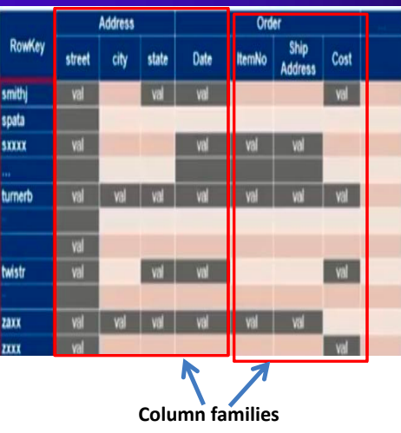
Data Model
Data stored in Hbase is located by its “rowkey”
RowKey is like a primary key from a relational database.
Records in Hbase are stored in sorted order, according to rowkey.
Data in a row are grouped together as Column Families. Each Column Family has one or more Columns
These Columns in a family are stored together in a low level storage file known as HFile

Slide 18
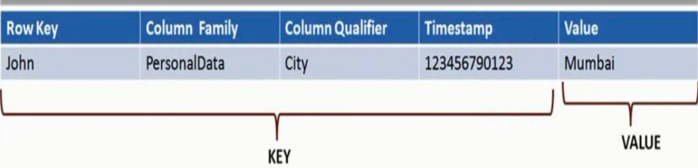
Cell in HBase Table
Data is stored in HBASE tables Cells.
Cell is a combination of row-key, column family, column qualifier and contains a value and a timestamp.
The entire cell, with the added structural information, is called Key Value.

Slide 19
Q. 7 ________________maps IPs to racks and data centers configured in
cassandra.yaml config file
A. Client requests
B. Partitioner
C. Snitch
D. None of the mentioned

Slide 20
Snitches
Snitches are used in Cassandra to map IPs to racks and Data Centers.
SimpleSnitch -
Unaware of Topology (DC and Rack-unaware).
Therefore unusable for multi-datacenter environments.
RackInfering
In this snitch we find out the location by rack and datacenter.
In this snitch the 2nd and 3rd octets of IP address corresponds to datacenter and rack.
101.102.103.104 = x.<DC octet>.<rack octet>.<node octet>
PropertyFileSnitch
This snitch uses the cassandra-topology.properties file to determine topology of network
EC2Snitch
EC2 Region = DC
Availability zone = rack

Slide 21
Q. 8 Consider the following statements:
Statement 1: Scale up: grow your cluster capacity by replacing with more powerful
machines.
Statement 2: Scale out: incrementally grow your cluster capacity by adding more
COTS machines (Components Off the Shelf).
A. Only statement 1 is true
B. Only statement 2 is true
C. Both statements are true
D. Both statements are false

Slide 22
Answer: C) Both statements are true
Explanation: The correct statements are:
Scale up: grow your cluster capacity by replacing with more powerful machines
Scale out: incrementally grow your cluster capacity by adding more COTS machines
(Components Off the Shelf)

Slide 23
Q. 9 A Bloom filter may give results that are false negative, i.e. it may return that that a value is not present in the table, even though it may be present?
A. True
B. False

Slide 24
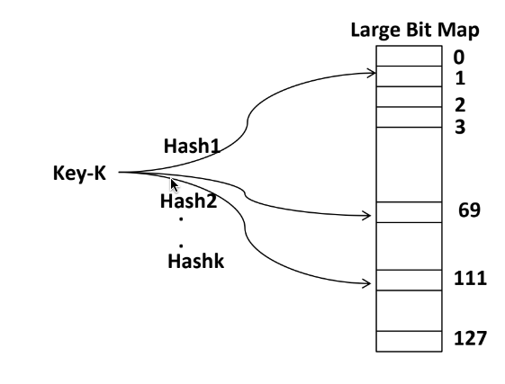
Bloom Filter
A bloom filter is a probabilistic data structure that is based on hashing
It is extremely space efficient and is typically used to add elements to a set and test if an element is in a set.
When testing if an element is in the bloom filter, false positives are possible.
It will either say that an element is definitely not in the set or that it is possible the element is in the set.
A bloom filter is very much like a hash table in that it will use a hash function to map a key to a bucket. However, it will not store that key in that bucket, it will simply mark it as filled.
So, many keys might map to same filled bucket, creating false positives.

Slide 25
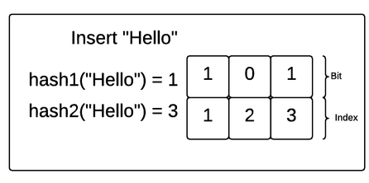
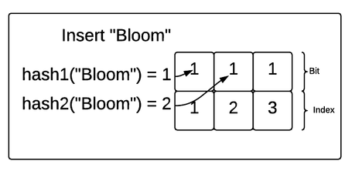
An empty bloom filter is a bit array of m bits, all of which are initially set to zero.
A bloom filter also includes a set of k hash functions with which we hash incoming values.
These hash functions must all have a range of 0 to m−1. If these hash functions match an incoming value with an index in the bit array, the bloom filter will make sure the bit at that position in the array is 1
Imagine that "House" also is hashed to the two indexes 1 and 3

